Slide 1

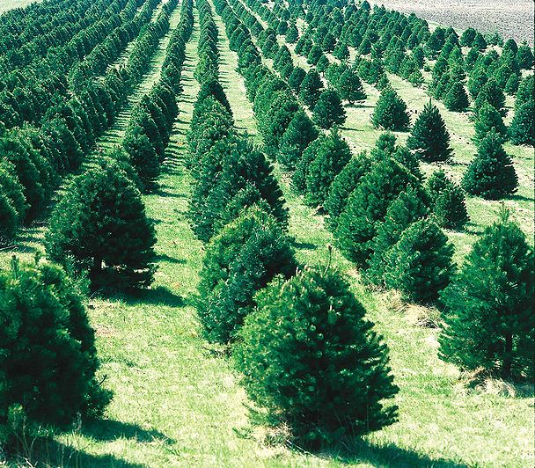
Merry MATHmas!
Ms. Dunn runs a Christmas Tree Farm. There are 4 trees in a row. There are 3 rows. How many trees are there at Ms. Dalrymple’s farm?

Slide 2
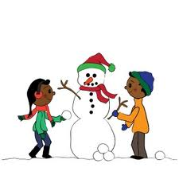
Merry MATHmas!
Ms. Randle and Ms. Highfield want to draw snowmen. Each snowman must be made using three balls of snow. How many balls would it take to make 4 snowmen?

Slide 3
Merry MATHmas!
Ms. Haley saw 12 reindeer in the stable. How many different ways can you build the number 12?

Slide 4

Merry MATHmas!
Mrs. Bartlett decided to make gingerbread cookies for some teachers at SES. How many arms and legs are there on 5 gingerbread cookies? Draw a picture to prove your answer.

Slide 5

Merry MATHmas!
Ms. Galbreath loves to hang candy canes around the house.
On the first day, she hung 2 red candy canes.
On the second day, she hung 1 green candy cane.
On the third day, she hung 2 red candy canes.
On the fourth day, she hung 1 green candy cane.
What will she hang on the 5th day? Prove your answer with a picture!
Challenge! How many candy canes did she hang in all over the 5 days?

Slide 6
Merry MATHmas!
Chippy the Elf made 5 toys on Monday, 3 toys on Tuesday, and 4 toys on Wednesday. How many toys did he make in all? Draw a picture to prove your answer.

Slide 7
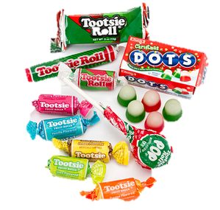
Merry MATHmas!
Ms. Inman has 2 bags of candy. Each bag has 10 pieces. How much candy does she have? Prove your answer with a picture.

Slide 8



Merry MATHmas!
Ms. Harris needs help decorating the bottom row of the tree. Draw a picture to show what the bottom row will look like.

Slide 9
Merry MATHmas!
Count the snowmen at the bottom of this slide.
How many are there?
How many different ways can you build this number?
If Ms. Paggett’s class built the same amount, how many would there be in all?

Slide 10

Merry MATHmas!
Ms. Fuson built 10 snowmen during recess on Monday. 4 melted on Tuesday, and 2 melted on Wednesday. How many snowmen were left?

